Slide 1
MANIFESTO NEPAL
A LL PA R TIES. A LL PR O M ISES. O N E SO LU TIO N

Slide 2

THE PROBLEMS
INFORMATION OVERLOAD
2) COMPLEX LANGUAGE
3) DIFFICULT IN COMPARISON
4 ) LOW ENGAGEMENT

Slide 3
SOLUTION
“MANIFESTO NEPAL”
IT IS A DIGITAL PLATFORM THAT PRE-LOADS ALL MAJOR PARTIES’ MANIFESTOS.
AI‐POWERED SUMMARIES
SIDE‐BY‐SIDE COMPARISON TOOL
INTERACTIVE
q&A
USERS CAN ASK AI-POWERED QUESTIONS LIKE:
“WHAT DOES EACH PARTY PLAN FOR YOUTH EMPLOYMENT?”
“WHICH PARTY FOCUSES MOST ON WOMEN’S RIGHTS?”
THE SYSTEM GENERATES SIDE-BY-SIDE COMPARISONS FOR EASY ANALYSIS.
KEYWORD SEARCH FUNCTION
NEUTRAL & VERIFIED INFORMATION

Slide 4
IT’S IMPACT
INFORMED VOTING
CITIZENS TO MAKE DATA-DRIVEN DECISIONS
ACCOUNTABILITY BY MAKING PROMISES VISIBLE

Slide 5
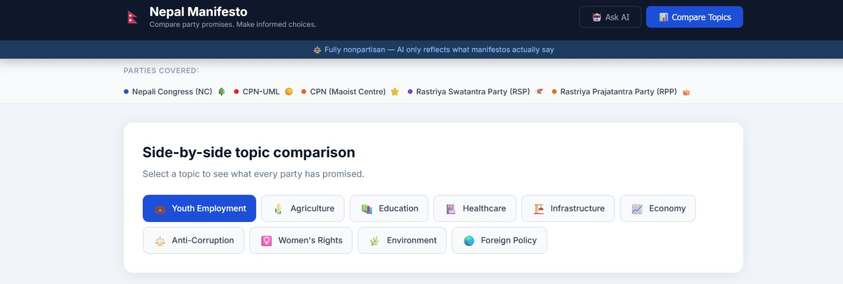
HOW IT WORKS
MANIFESTOS LOADED
ASK AI
AI ANSWERS
COMPARE PARTIES
SEARCH TOPICS
.

Slide 6

BENEFITS
SAVES TIME, SIMPLIFIES COMPLEX DOCUMENTS. EMPOWERS CITIZENS WITH ACCESSIBLE KNOWLEDGE. PROMOTES INFORMED DECISION‐MAKING. ENCOURAGES TRANSPARENCY AND ACCOUNTABILITY.

Slide 7
FUTURE VISION
EXPAND TO LOCAL, NATIONAL, AND GLOBAL ELECTIONS. SUPPORT MULTIPLE LANGUAGES FOR WIDER REACH. PERSONALIZED INSIGHTS BASED ON USER INTERESTS. ADVANCED VISUALS: CHARTS, TIMELINES, DASHBOARDS. FACT‐CHECKING INTEGRATION TO TRACK PROMISES.
MOBILE APP FOR EASY ACCESS ANYWHERE.
CITIZEN FEEDBACK LOOP FOR ENGAGEMENT.

Slide 8
THANK YOU

